Slide 1
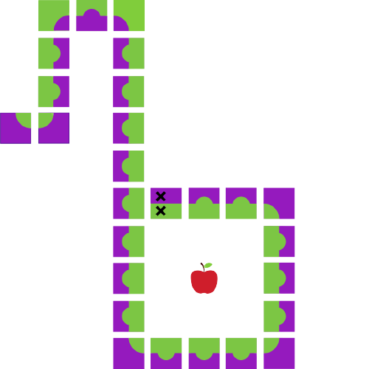
Java Workshop 1
Aadila Ali Sabry

Slide 2





Slide 3
Your Turn!

Slide 4
Getting Started with an IDE
Option 1: Replit (Web IDE)
Navigate to the Getting Started with Java doc
Instructions for replit start on the first page
Start with replit. If you have time, try installing Java and IntelliJ to code on your local machine
Option 2: IntelliJ
Navigate to page 4 of Getting Started
Follow the instructions on downloading and installing JDK and IntelliJ (you’ll want both—one is necessary for translating java code to computer code, and the other is to help you write it.)
Notes:
https://docs.google.com/document/d/1WFKGYrueZfJ1j3K1tw14Z7m7psvjtrHR71DuhfPgR5w/edit?usp=sharing

Slide 5
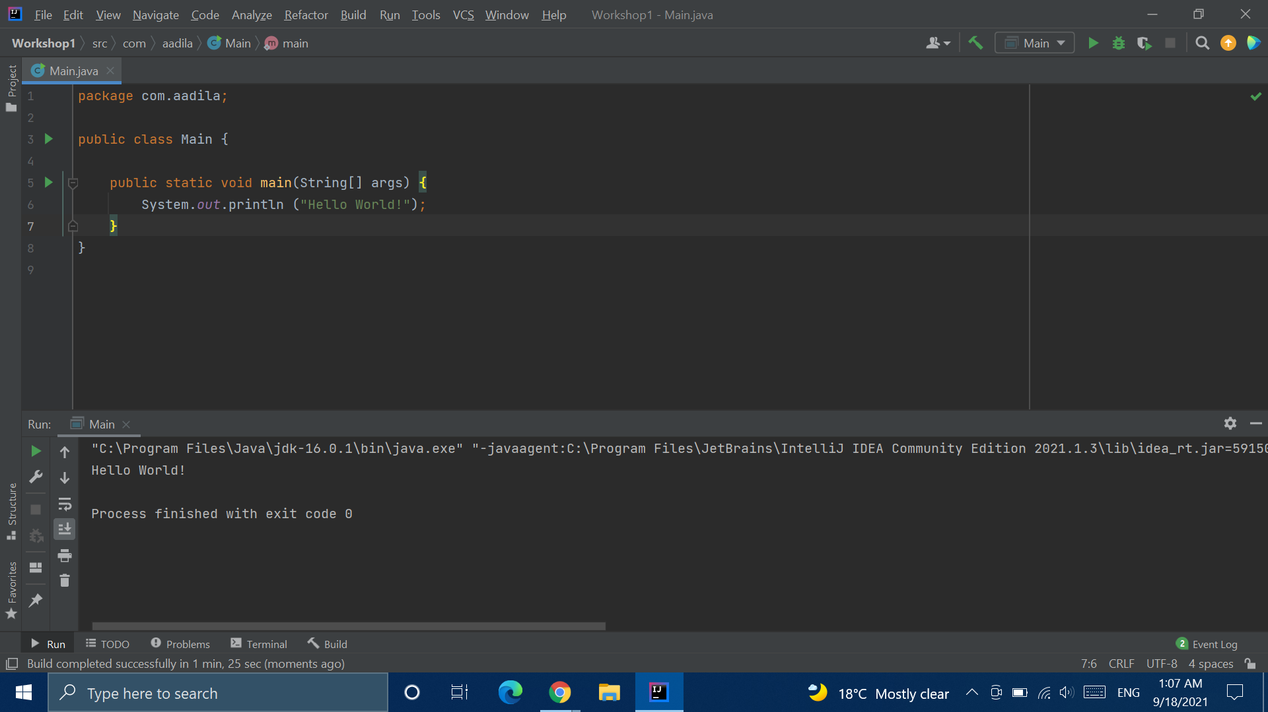
Your First Program
Code
(Everyone’s, really)
Console
Notes:
https://docs.google.com/document/d/1G6dtOS_VpKaOKQ4TlE3AKLp11iaKvE4Nva1SOU1BQ-U/edit?usp=sharing

Slide 6
What Did I Just Write?
main Method Declaration
Class Declaration
Fun Fact:
Java is an object oriented programming language
Print Statement

Slide 7
Careful!
Curly Braces!!!
Semicolons!!!

Slide 8
Terms!

Slide 9
Strings
Strings are any combination of letters, numbers, white spaces and other characters (such as ‘!’ and ‘~’)
They are enclosed by double quotes (“ ”) in java
Try printing different Strings to the screen using the print command!
Literally, Strings...of text.

Slide 10
Escape Sequences
What if I want to print
“It’s rainy today,” she said.
to the screen?
The quotes at the beginning of the sentence end the String!
Many characters have special meanings to the compiler in java
How do we get around (or “escape”) this situation?

Slide 11
Escape Sequence | Description
\t | Insert a tab in the text at this point.
\b | Insert a backspace in the text at this point.
\n | Insert a newline in the text at this point.
\r | Insert a carriage return in the text at this point.
\f | Insert a form feed in the text at this point.
\' | Insert a single quote character in the text at this point.
\" | Insert a double quote character in the text at this point.
\\ | Insert a backslash character in the text at this point.
Notes:
Source: https://javahungry.blogspot.com/2020/06/escape-sequences.html
https://replit.com/@AadilaAliSabry/Escape-Sequence-Practice#Main.java

Slide 12
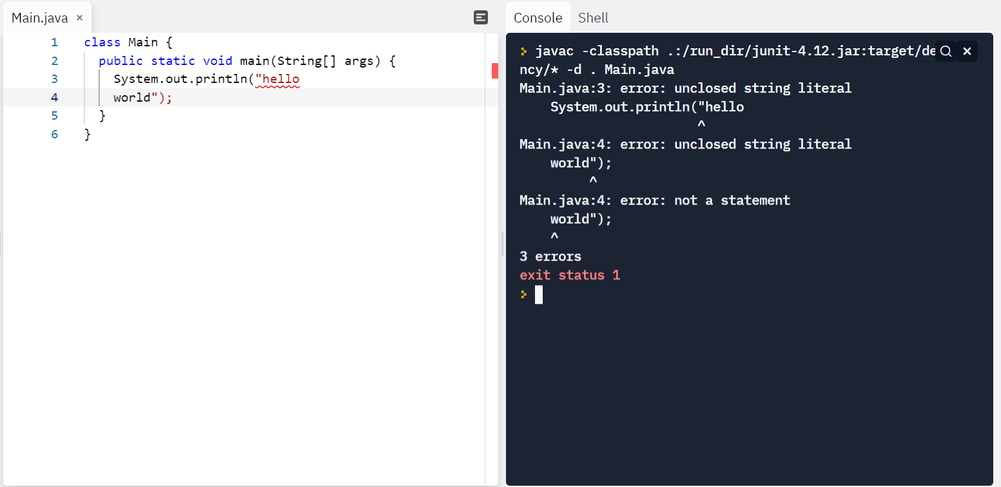

Slide 13
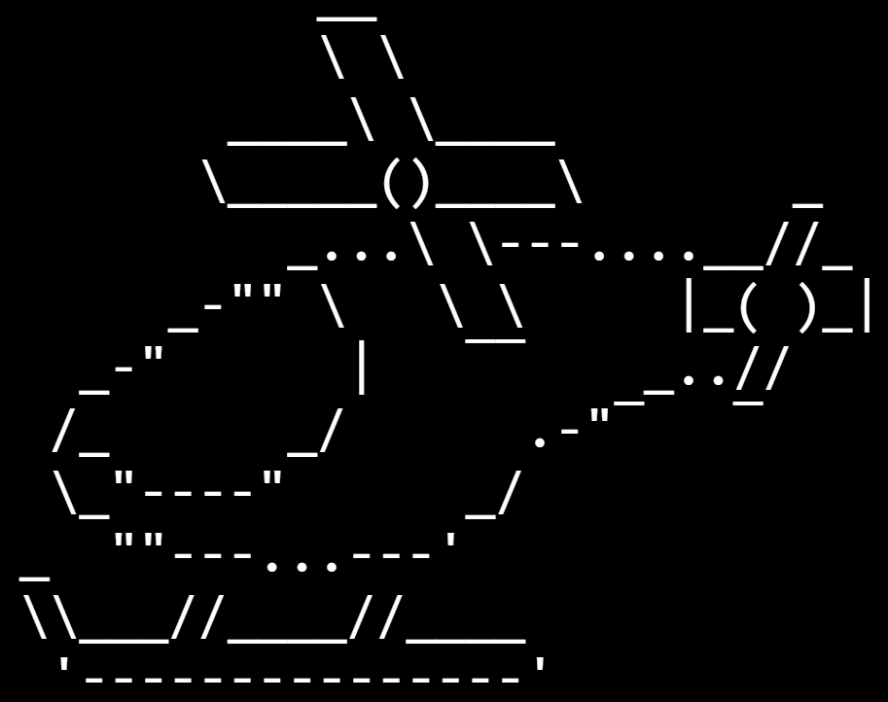
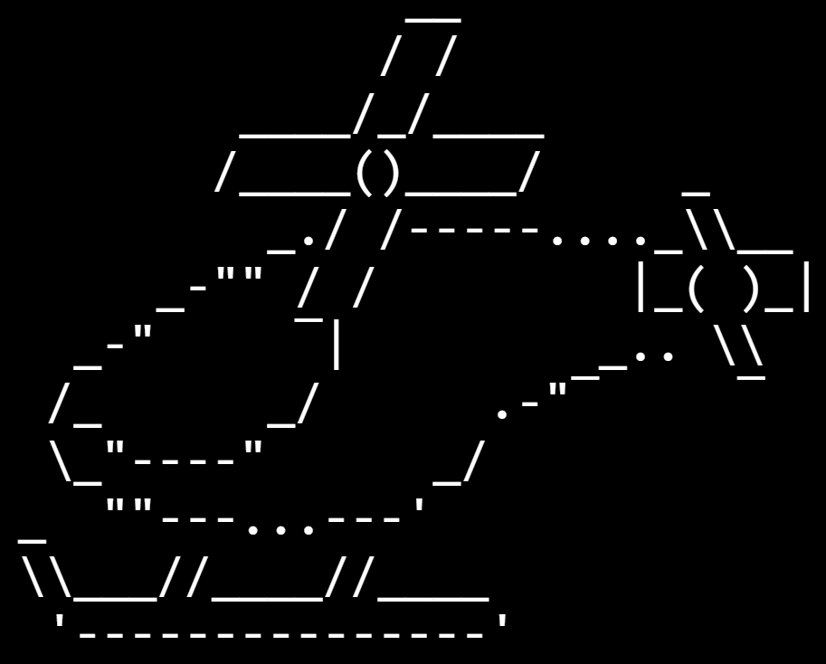
Animations!
Notes:
https://replit.com/@AadilaAliSabry/ASCII-Art#Main.java

Slide 14
Break Time

Slide 15
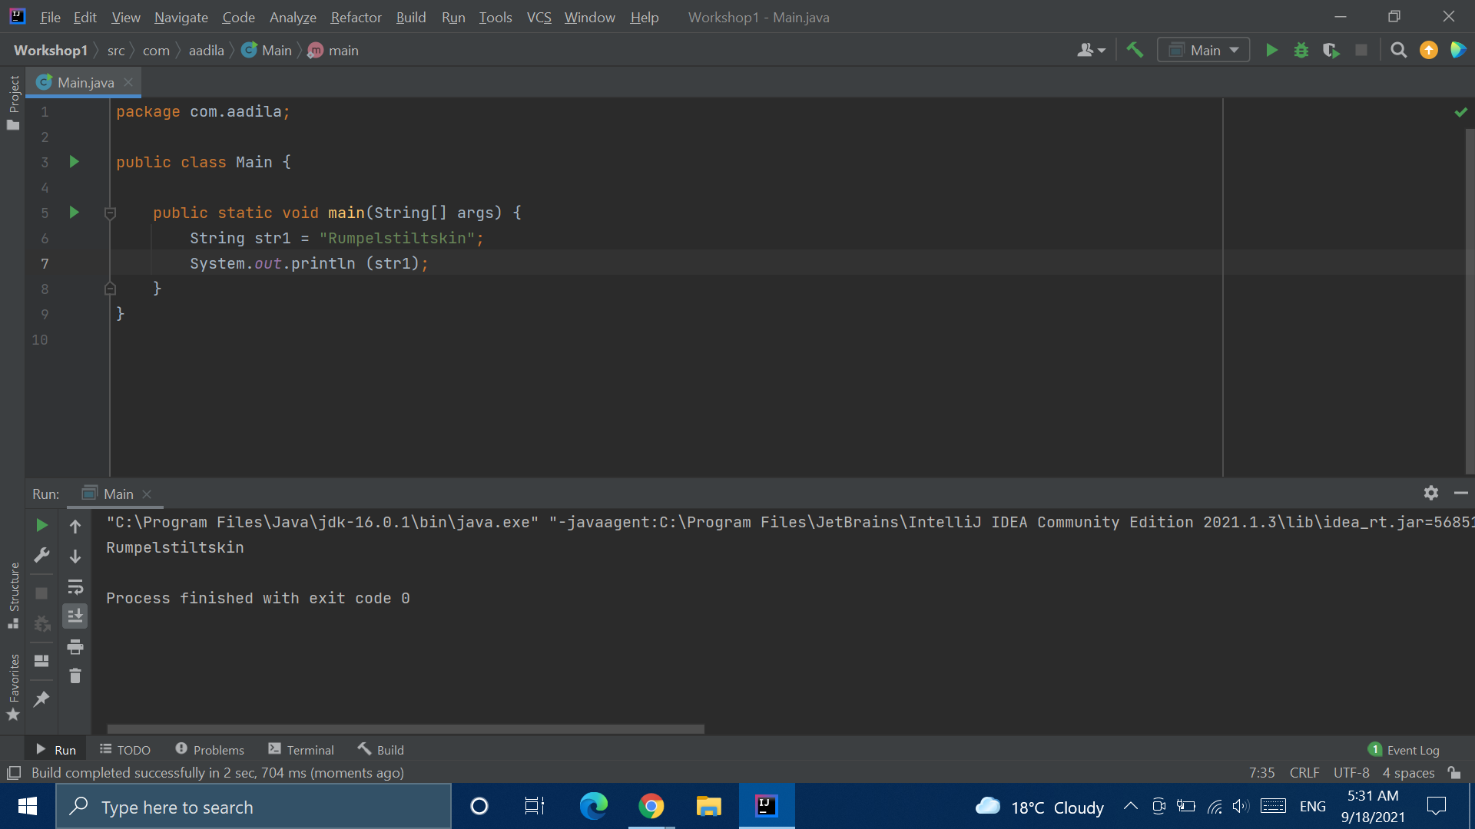
Strings are Variables

Slide 16
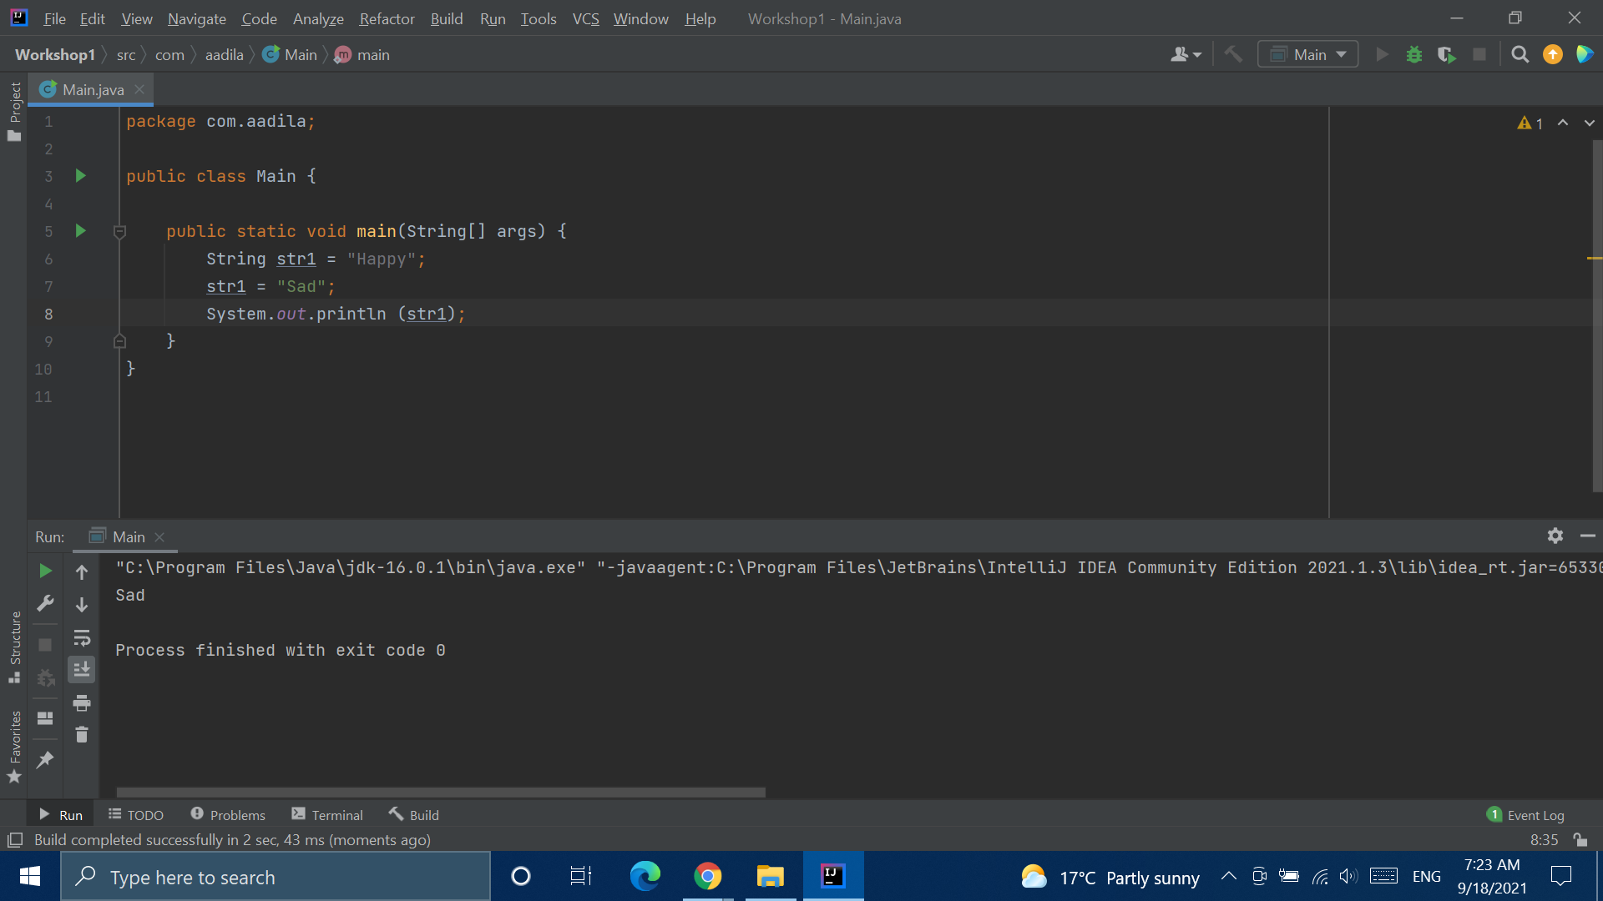

Slide 17
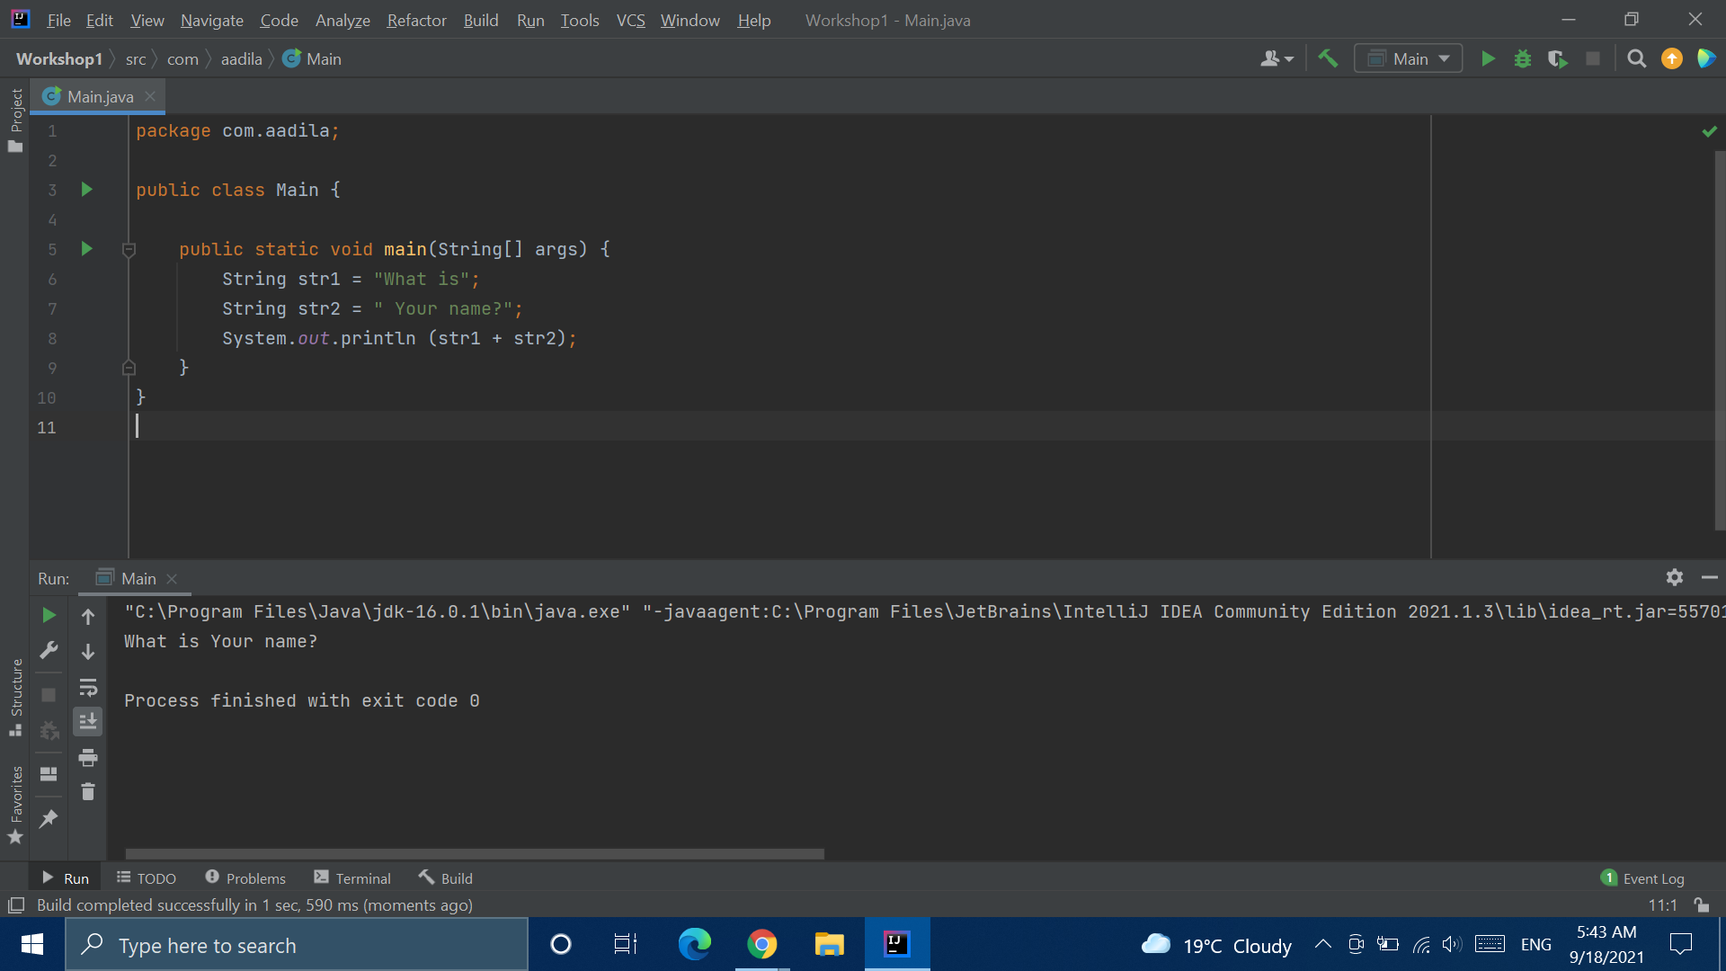

Slide 18
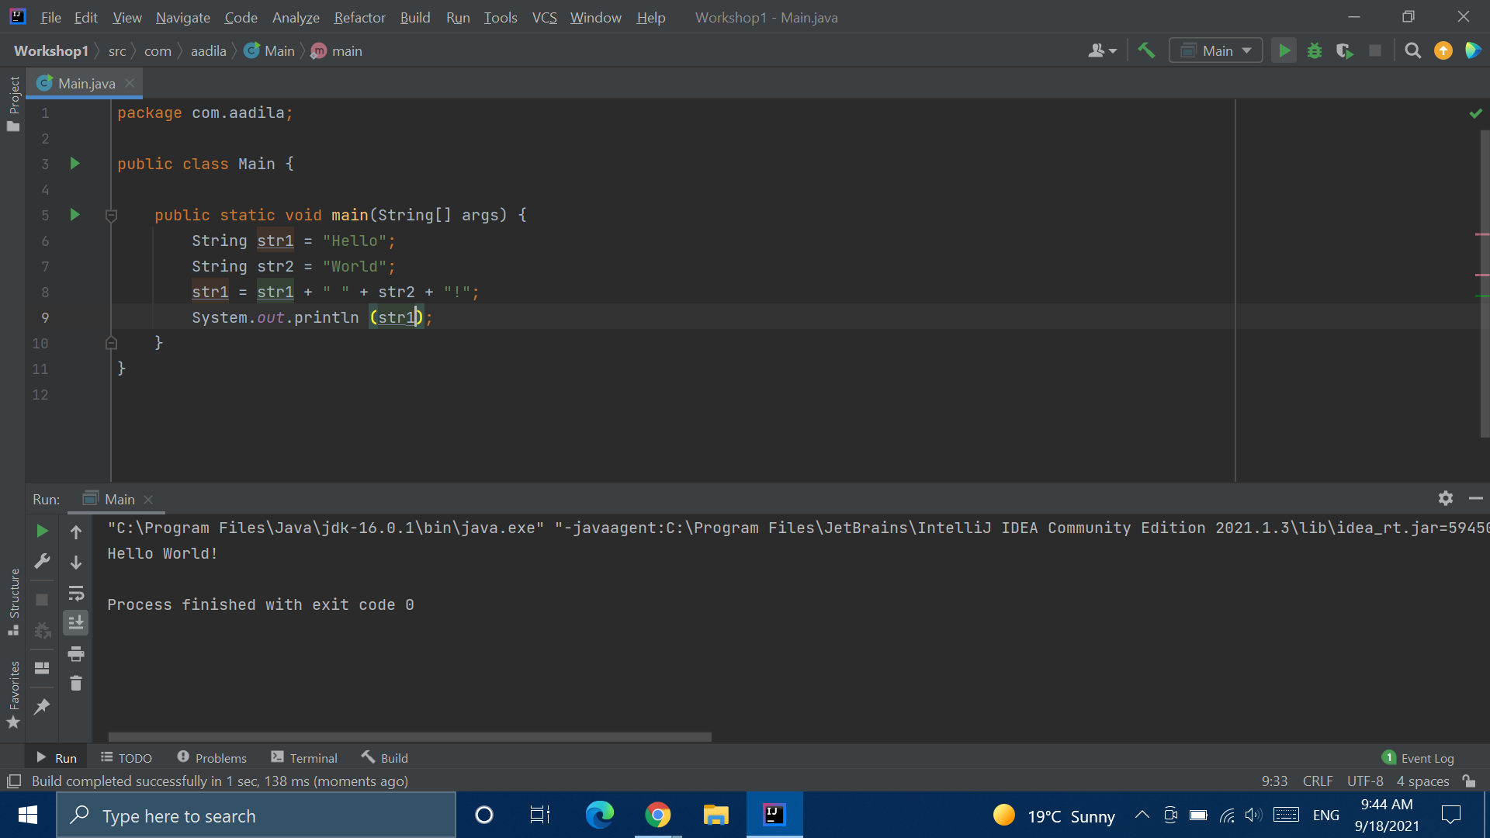

Slide 19


Slide 20
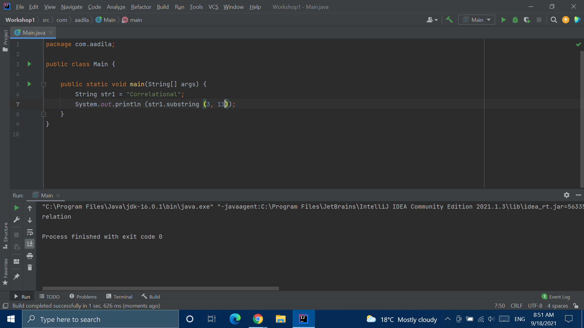

Slide 21
Pig Latin
We’re going to write a program to translate English to Pig Latin!
Notes:
https://web.ics.purdue.edu/~morelanj/RAO/prepare2.html
https://replit.com/@AadilaAliSabry/Pig-Latin#Main.java

Slide 22
Reverse Sentences
Notes:
https://replit.com/@AadilaAliSabry/Reverse-The-Words#Main.java

Slide 23


Slide 24
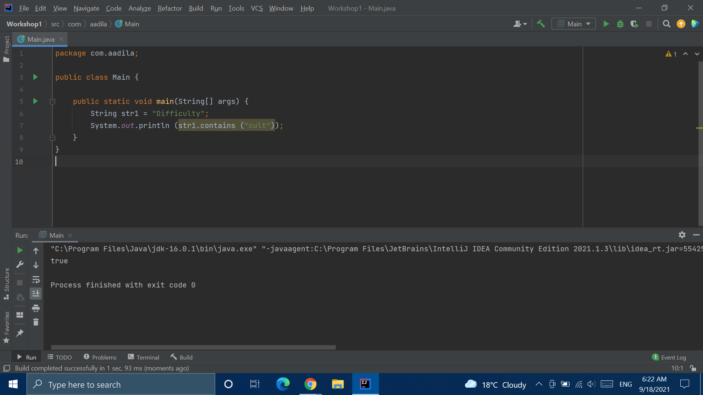

Slide 25
Why Code?

